Slide 1
CRUD - MongoDB
Jigna Patel

Slide 2


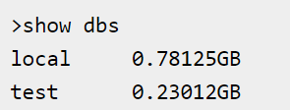
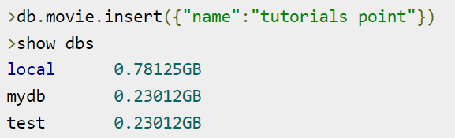
MongoDB - Create Database
Syntax : Basic syntax of use DATABASE statement is as follows −
use DATABASE_NAME
To check your currently selected database, use the command db
If you want to check your databases list, use the command show dbs.
To display database, you need to insert at least one document into it.

Slide 3
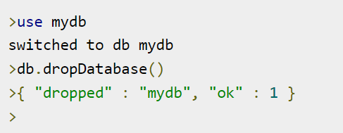
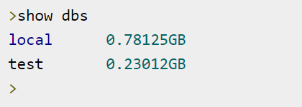
MongoDB - Drop Database
Syntax : Basic syntax of drop DATABASE statement is as follows −
db.dropDatabase()
If you want to delete new database <mydb>, then dropDatabase() command would be
Now check list of databases.

Slide 4
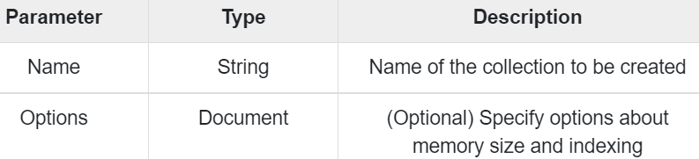
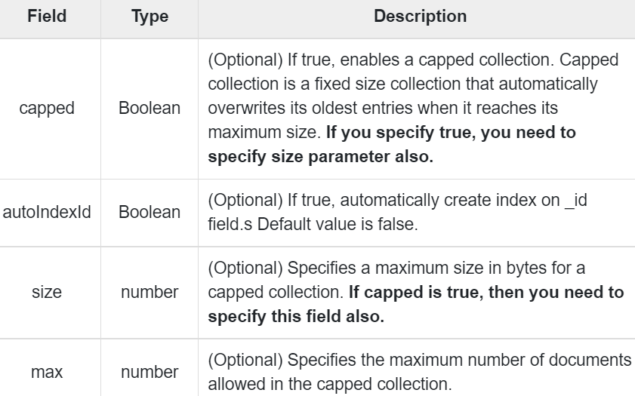
MongoDB - Create Collection
Syntax : Basic syntax of createCollection() command is as follows −
db.createCollection(name, options)

Slide 5
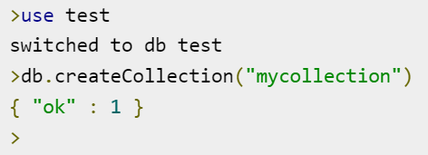
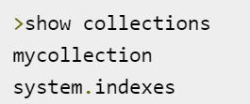
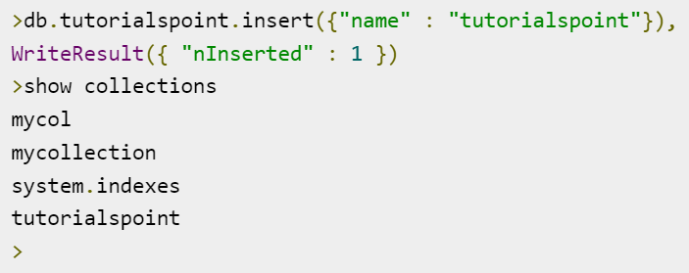
Examples
> db.createCollection("mycol", { capped : true, autoIndexID : true, size : 6142800, max : 10000 } )
In MongoDB, you don't need to create collection. MongoDB creates collection automatically, when you insert some document.

Slide 6
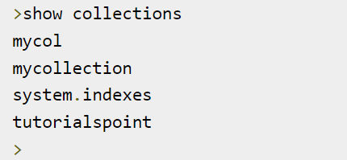
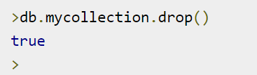
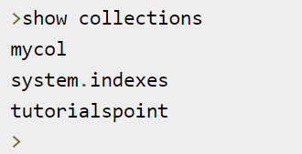
MongoDB - Drop Collection
Syntax : Basic syntax of drop() command is as follows −
db.COLLECTION_NAME.drop()

Slide 7
MongoDB - Insert Document
The insert() Method
The insertOne() method
The insertMany() method
Syntax : The basic syntax of insert() command is as follows −
db.COLLECTION_NAME.insert(document)
Syntax : The basic syntax of insert() command is as follows −
db.COLLECTION_NAME.insertOne(document)
Syntax : The basic syntax of insert() command is as follows −
db. COLLECTION_NAME.insertMany([doc1,doc2,doc3])

Slide 8
> db.users.insert({ title: "MongoDB Overview", description: "MongoDB is no sql database",tags: ['mongodb', 'database', 'NoSQL’], likes: 100})
db.empDetails.insertOne({ First_Name: "Radhika",
Last_Name: "Sharma",
Date_Of_Birth: "1995-09-26",
e_mail: "radhika_sharma.123@gmail.com",
phone: "9848022338" })
db.empDetails.insertMany([ { First_Name: "Radhika",
Last_Name: "Sharma",
Date_Of_Birth: "1995-09-26",
e_mail: "radhika_sharma.123@gmail.com",
phone: "9848022338“},
{ First_Name: "Radhika",
Last_Name: "Sharma",
Date_Of_Birth: "1995-09-26",
e_mail: "radhika_sharma.123@gmail.com",
phone: "9848022338“}])

Slide 9
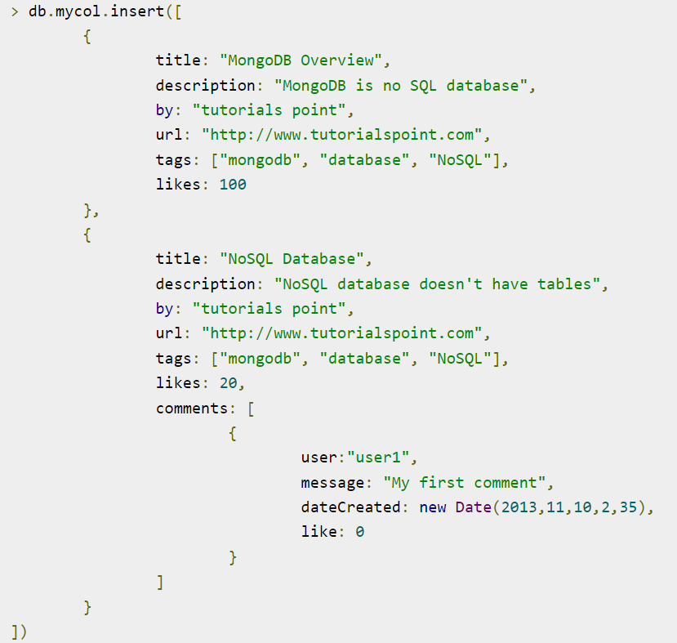
MongoDB - Query Document
To query data from MongoDB collection, you need to use MongoDB's find() method.
Syntax : The basic syntax of find() method is as follows −
db.COLLECTION_NAME.find()

Slide 10
> db.mycol.find()
{ "_id" : ObjectId("5dd4e2cc0821d3b44607534c"), "title" : "MongoDB Overview", "description" : "MongoDB is no SQL database", "by" : "tutorials point", "url" : "http://www.tutorialspoint.com", "tags" : [ "mongodb", "database", "NoSQL" ], "likes" : 100 }
{ "_id" : ObjectId("5dd4e2cc0821d3b44607534d"), "title" : "NoSQL Database", "description" : "NoSQL database doesn't have tables", "by" : "tutorials point", "url" : "http://www.tutorialspoint.com", "tags" : [ "mongodb", "database", "NoSQL" ], "likes" : 20, "comments" : [ { "user" : "user1", "message" : "My first comment", "dateCreated" : ISODate("2013-12-09T21:05:00Z"), "like" : 0 } ] }

Slide 11
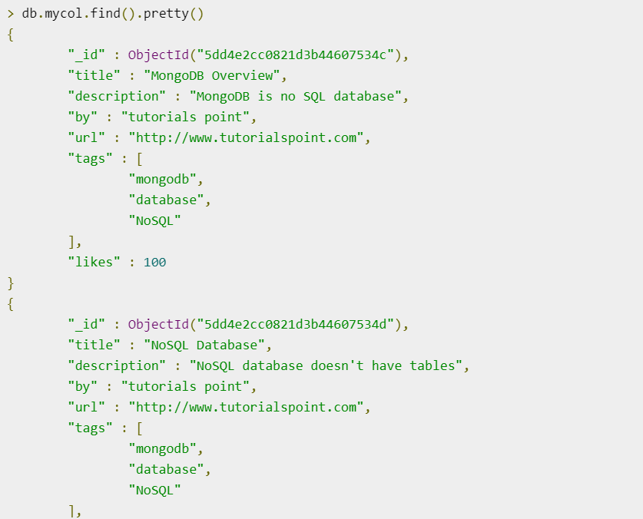
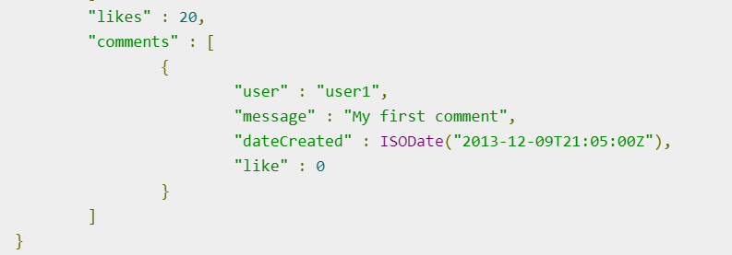

Slide 12
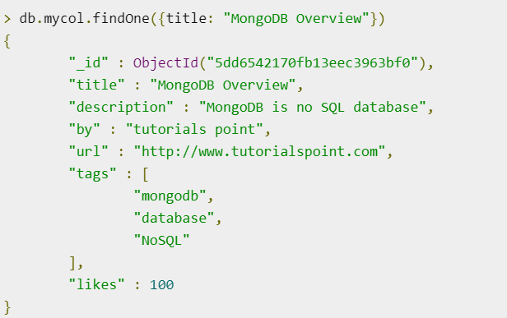
Apart from the find() method, there is findOne() method, that returns only one document.
Syntax : db.COLLECTIONNAME.findOne()

Slide 13
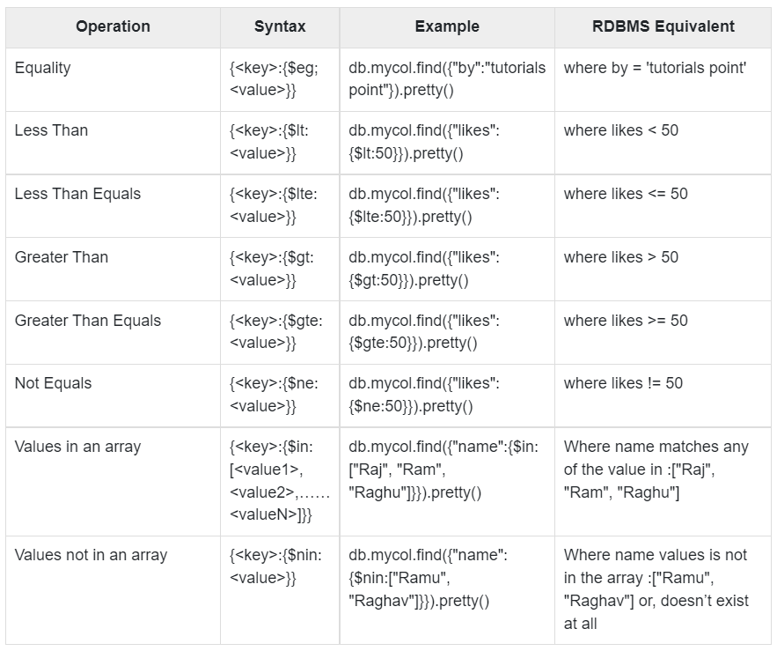
RDBMS Where Clause Equivalents in MongoDB

Slide 14
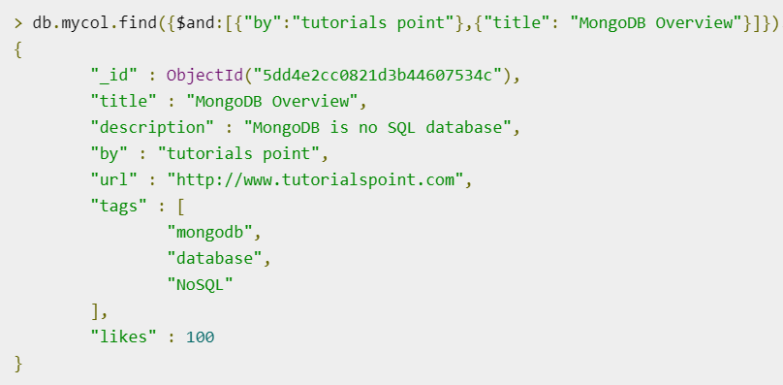
AND in MongoDB
To query documents based on the AND condition, you need to use $and keyword. Following is the basic syntax of AND −
>db.mycol.find({ $and: [ {<key1>:<value1>}, { <key2>:<value2>} ] })

Slide 15
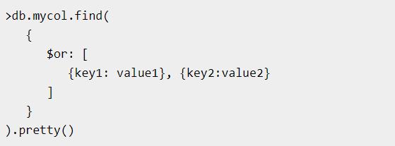
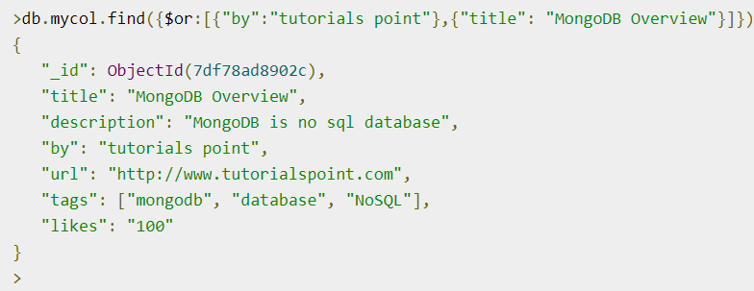
OR in MongoDB
To query documents based on the OR condition, you need to use $or keyword. Following is the basic syntax of OR −

Slide 16
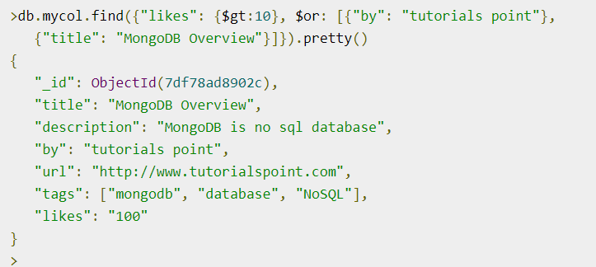
Using AND and OR Together
documents that have likes greater than 10 and whose title is either 'MongoDB Overview' or by is 'tutorials point'. Equivalent SQL where clause is 'where likes>10 AND (by = 'tutorials point' OR title = 'MongoDB Overview')'

Slide 17
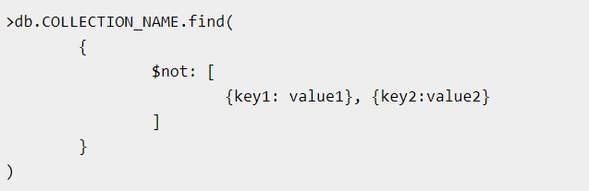
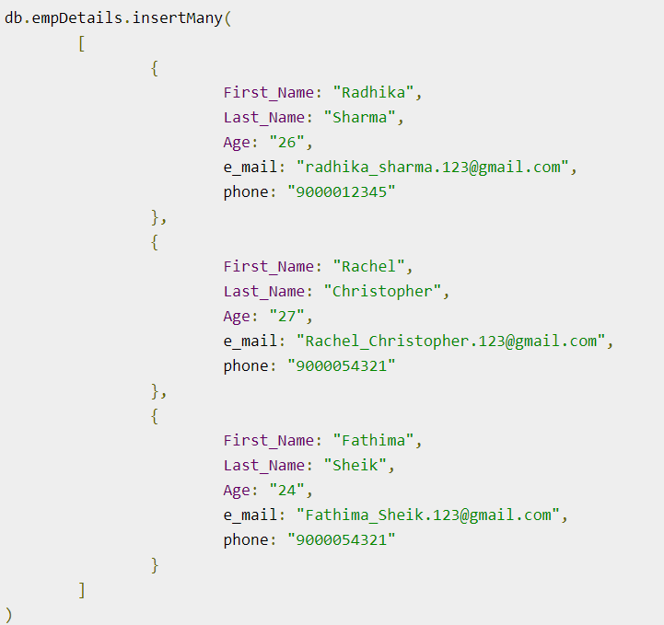
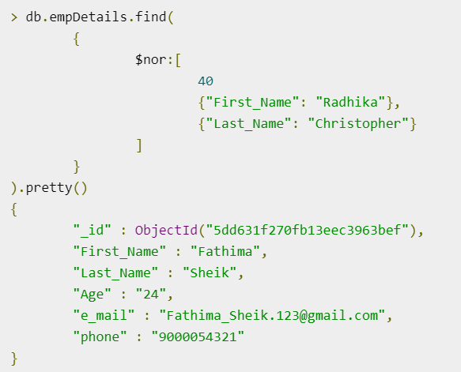
NOR in MongoDB
Syntax : To query documents based on the NOT condition, you need to
use $not keyword. Following is the basic syntax of NOT −
Example
Assume we have inserted 3 documents in the collection empDetails as shown below −

Slide 18
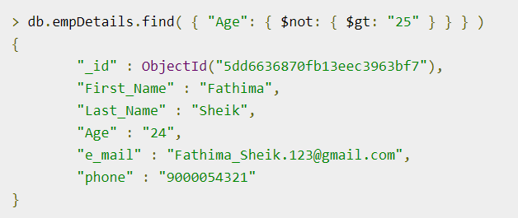
NOT in MongoDB

Slide 19

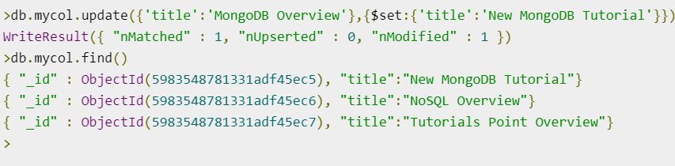
MongoDB - Update Document
Syntax : The basic syntax of update() method is as follows −
>db.COLLECTION_NAME.update(SELECTION_CRITERIA, UPDATED_DATA)
Consider the mycol collection has the following data.
Following example will set the new title 'New MongoDB Tutorial' of the documents whose title is 'MongoDB Overview

Slide 20
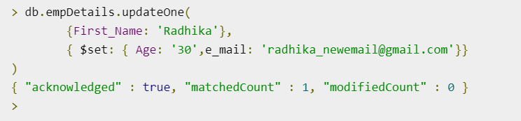
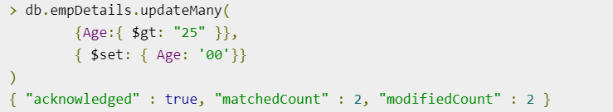

Slide 21
MongoDB - Delete Document
The remove() Method
MongoDB's remove() method is used to remove a document from the collection. remove() method accepts two parameters. One is deletion criteria and second is justOne flag.
deletion criteria − (Optional) deletion criteria according to documents will be removed.
justOne − (Optional) if set to true or 1, then remove only one document.

Slide 22
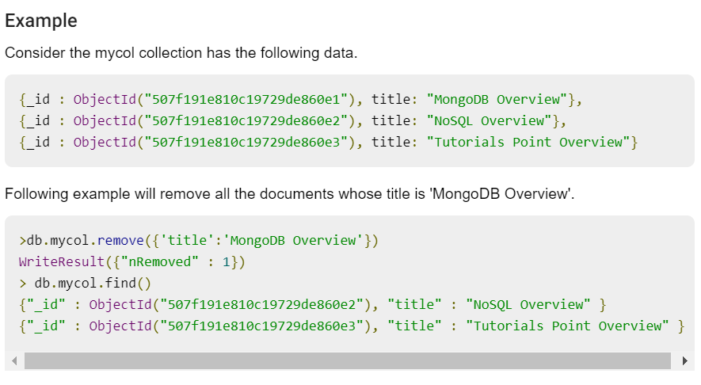

Slide 23
Remove Only One
If there are multiple records and you want to delete only the first record, then set justOne parameter in remove() method.
>db.COLLECTION_NAME.remove(DELETION_CRITERIA,1)
Remove All Documents
If you don't specify deletion criteria, then MongoDB will delete whole documents from the collection. This is equivalent of SQL's truncate command.
> db.mycol.remove({})
WriteResult({ "nRemoved" : 2 })
> db.mycol.find()

Slide 24
MongoDB - Sort Records
The sort() Method
To sort documents in MongoDB, you need to use sort() method. The method accepts a document containing a list of fields along with their sorting order. To specify sorting order 1 and -1 are used. 1 is used for ascending order while -1 is used for descending order.
Syntax : The basic syntax of sort() method is as follows −
>db.COLLECTION_NAME.find().sort({KEY:1})

Slide 25
